Slide 1

Railway Management System
Welcome to our presentation on the Railway Management System, a comprehensive database project designed to showcase the power and practicality of Database Management Systems in real-world applications. This project highlights the critical role of robust database solutions in managing complex transportation networks.
Group-1
Notes:
ABCD

Slide 2



Introduction to DBMS and Its Real-World Impact
The Foundation of Data
Database Management Systems (DBMS) are the backbone of modern information technology, providing a structured way to store, retrieve, and manage data efficiently. They are essential for any application dealing with large volumes of information.
Data Storage
Organized and secure storage.
Efficient Retrieval
Quick access to information.
Group-1

Slide 3
Project Overview: Managing the Railways
What is a Railway Management System?
Purpose and Efficiency
Key Areas of Management
The primary goal is to enhance the efficiency of railway operations. It helps in effectively managing trains, passenger information, intricate schedules, and revenue generation.
Train routing and availability
Our Railway Management System is a database application designed to streamline the operations of a railway network. It acts as a central hub for all critical data, from train details to passenger bookings.
Passenger booking and seating
Dynamic schedule adjustments
Revenue tracking and analysis
Group-1

Slide 4

Why This Project? Bridging Theory and Practice
This project was chosen for its unparalleled ability to demonstrate complex DBMS concepts within a tangible, real-world context.
Real-life Data Intensity
Railway systems are inherently data-intensive, making them perfect case studies for database design and implementation. Every train movement, every ticket sold, every passenger interaction generates valuable data.
Comprehensive DBMS Application
It utilizes a broad spectrum of DBMS concepts, including: tables, relationships, joins, subqueries, and views, offering a holistic learning experience.
Practical Design & Queries
The project offers hands-on experience in practical database design and constructing sophisticated SQL queries for various operational needs.
Group-1

Slide 5
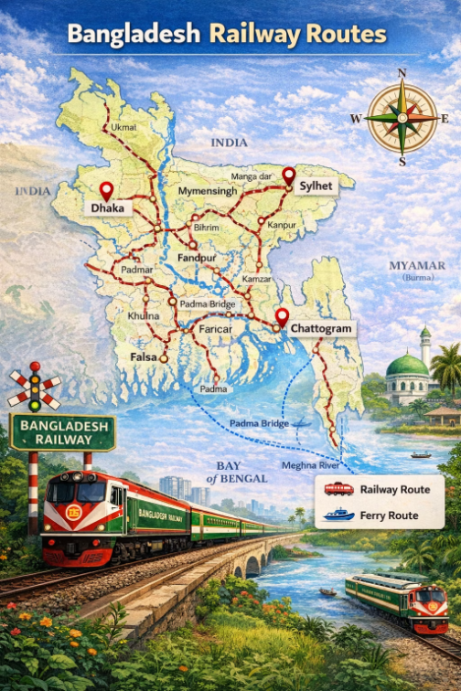
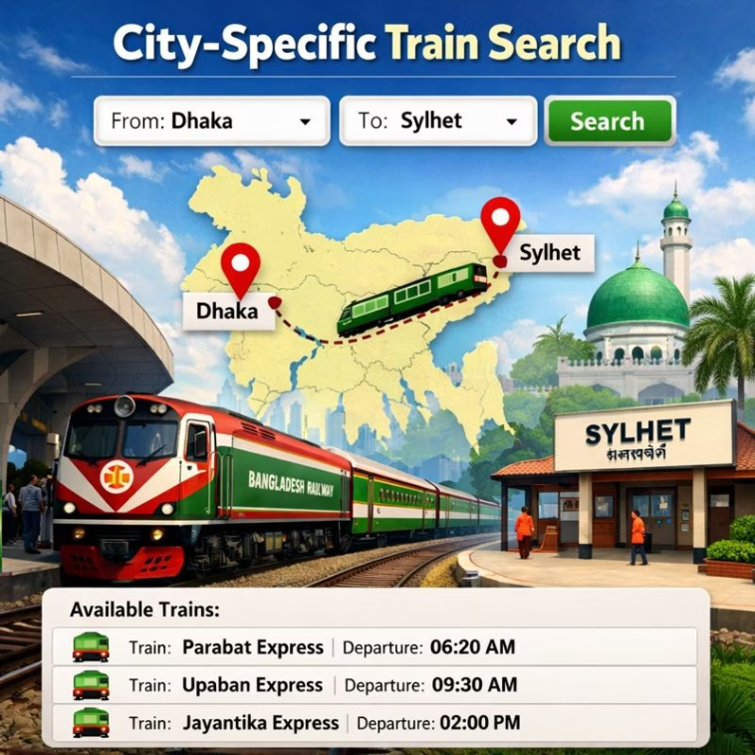
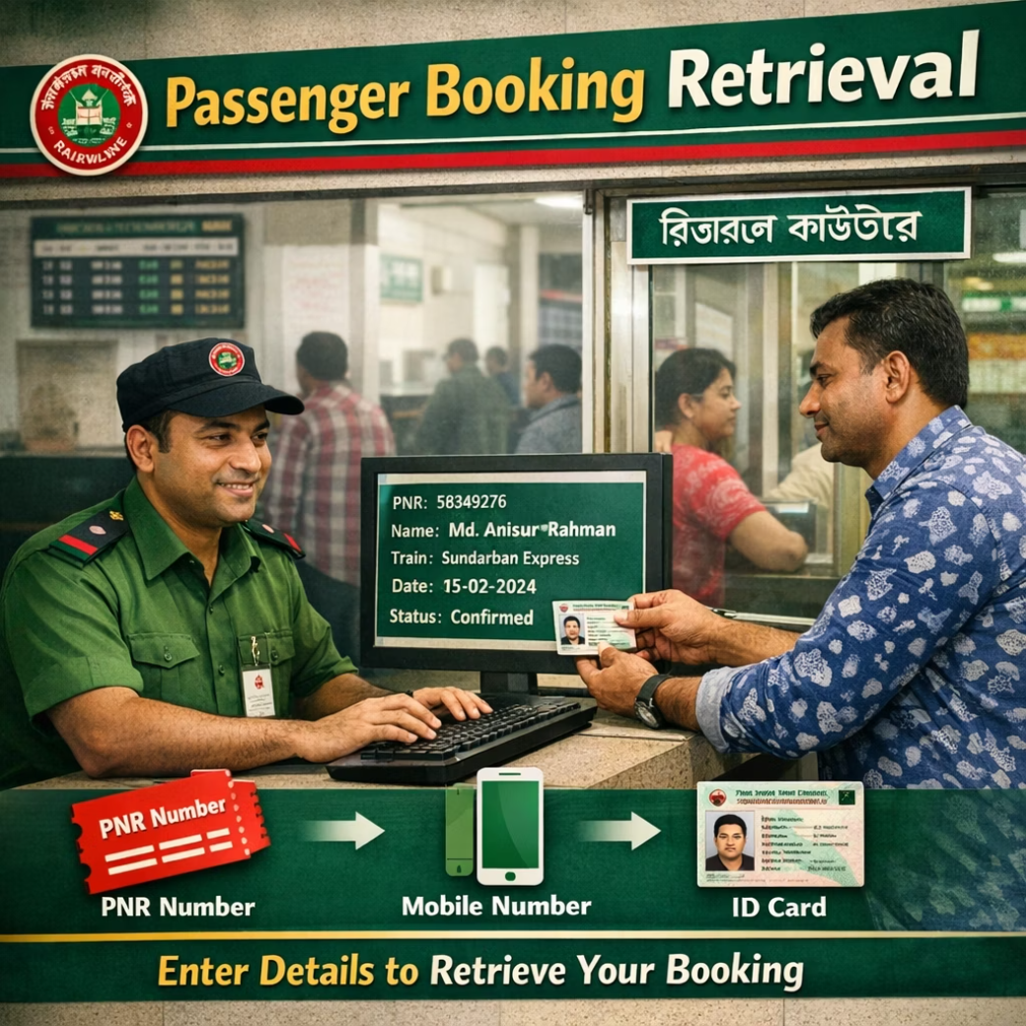
Database Features Implemented
Our system implements several key database features essential for effective railway management.
1
2
3
Train Information Listing
City-Specific Train Search
Passenger Booking Retrieval
Easily list all trains, including their source and destination station names, providing clarity and comprehensive overview for users.
Utilize subqueries to efficiently find all trains originating from a specific city, enabling precise travel planning.
Quickly retrieve a list of all passengers booked for a particular train (e.g., Train ID = 101).
Group-1

Slide 6

Dynamic Data with Views
Views provide simplified and customized perspectives of our complex database, enhancing usability and security without altering underlying data.
1
Revenue per Journey Date
This view aggregates financial data to show the total revenue generated for each journey date, providing critical insights for financial analysis.
2
Seat Occupancy View
A view that compares booked seats versus total available seats for every train, aiding in capacity management and ticket sales strategies.
Group-1

Slide 7




Technologies Underpinning the System
The Railway Management System leverages industry-standard technologies to ensure robust and efficient operation.
Database Management System
Powered by MySQL or Oracle, providing a reliable and scalable foundation for data storage and retrieval.
SQL Queries
Extensive use of SELECT, JOIN, SUBQUERY, VIEW , and TRIGGER commands for powerful data manipulation and analysis.
ER Diagram
Designed with a clear Entity-Relationship Diagram for optimal database architecture.
Group-1

Slide 8
Key Learning Outcomes
This project provided invaluable insights and practical experience in database management.
Practical SQL Mastery
1
Developed a deeper understanding and practical application of complex SQL queries and views for various scenarios.
Real-World Database Design
2
Gained hands-on experience in designing a database for a complex, operational system, considering scalability and efficiency.
Data Integrity & Relationships
3
Reinforced knowledge of maintaining data integrity, establishing robust relationships, and ensuring data consistency across the system.
Group-1

Slide 9
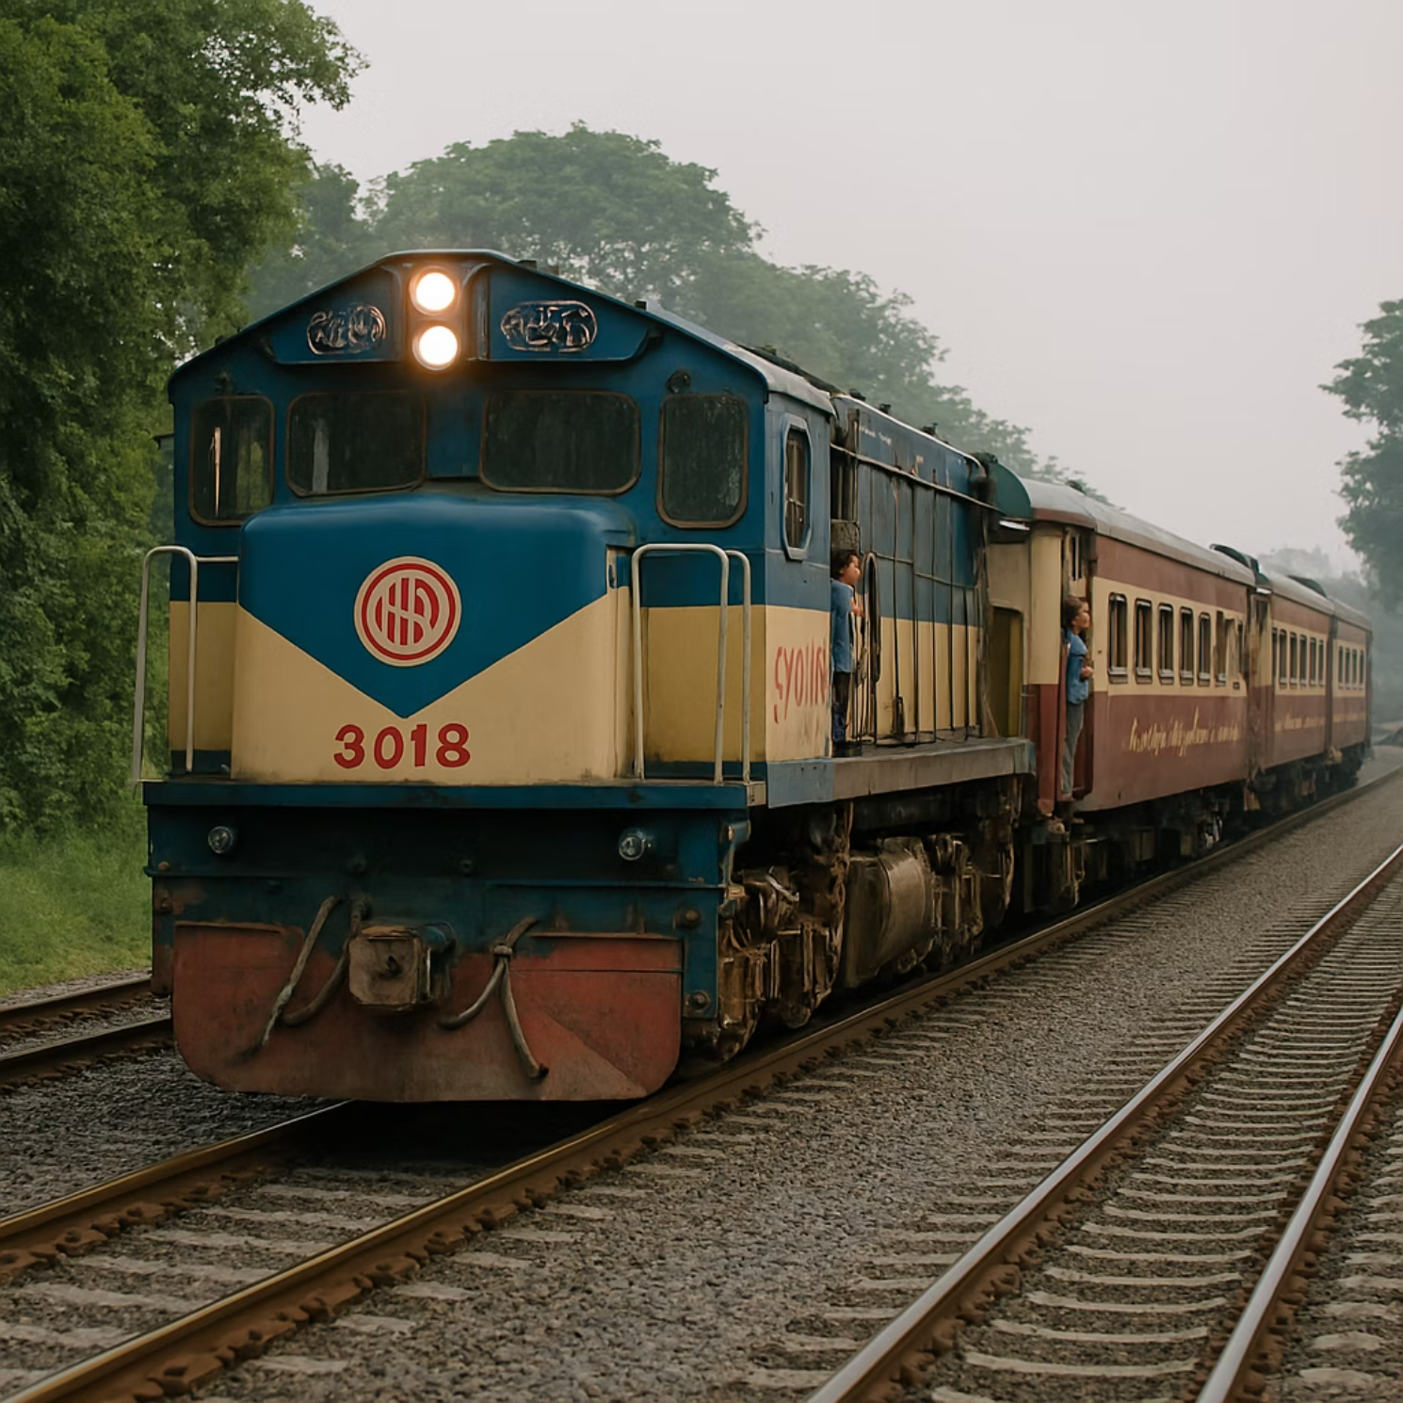
Conclusion: Beyond the Tracks
This Railway Management System project successfully demonstrated the application of DBMS principles to simulate and manage real-life railway operations.
Project Summary
A functional database system managing trains, passengers, schedules, and revenue.
Real-world Reflection
Accurately mirrors the complexities and data demands of a modern railway network.
Group-1

Slide 10
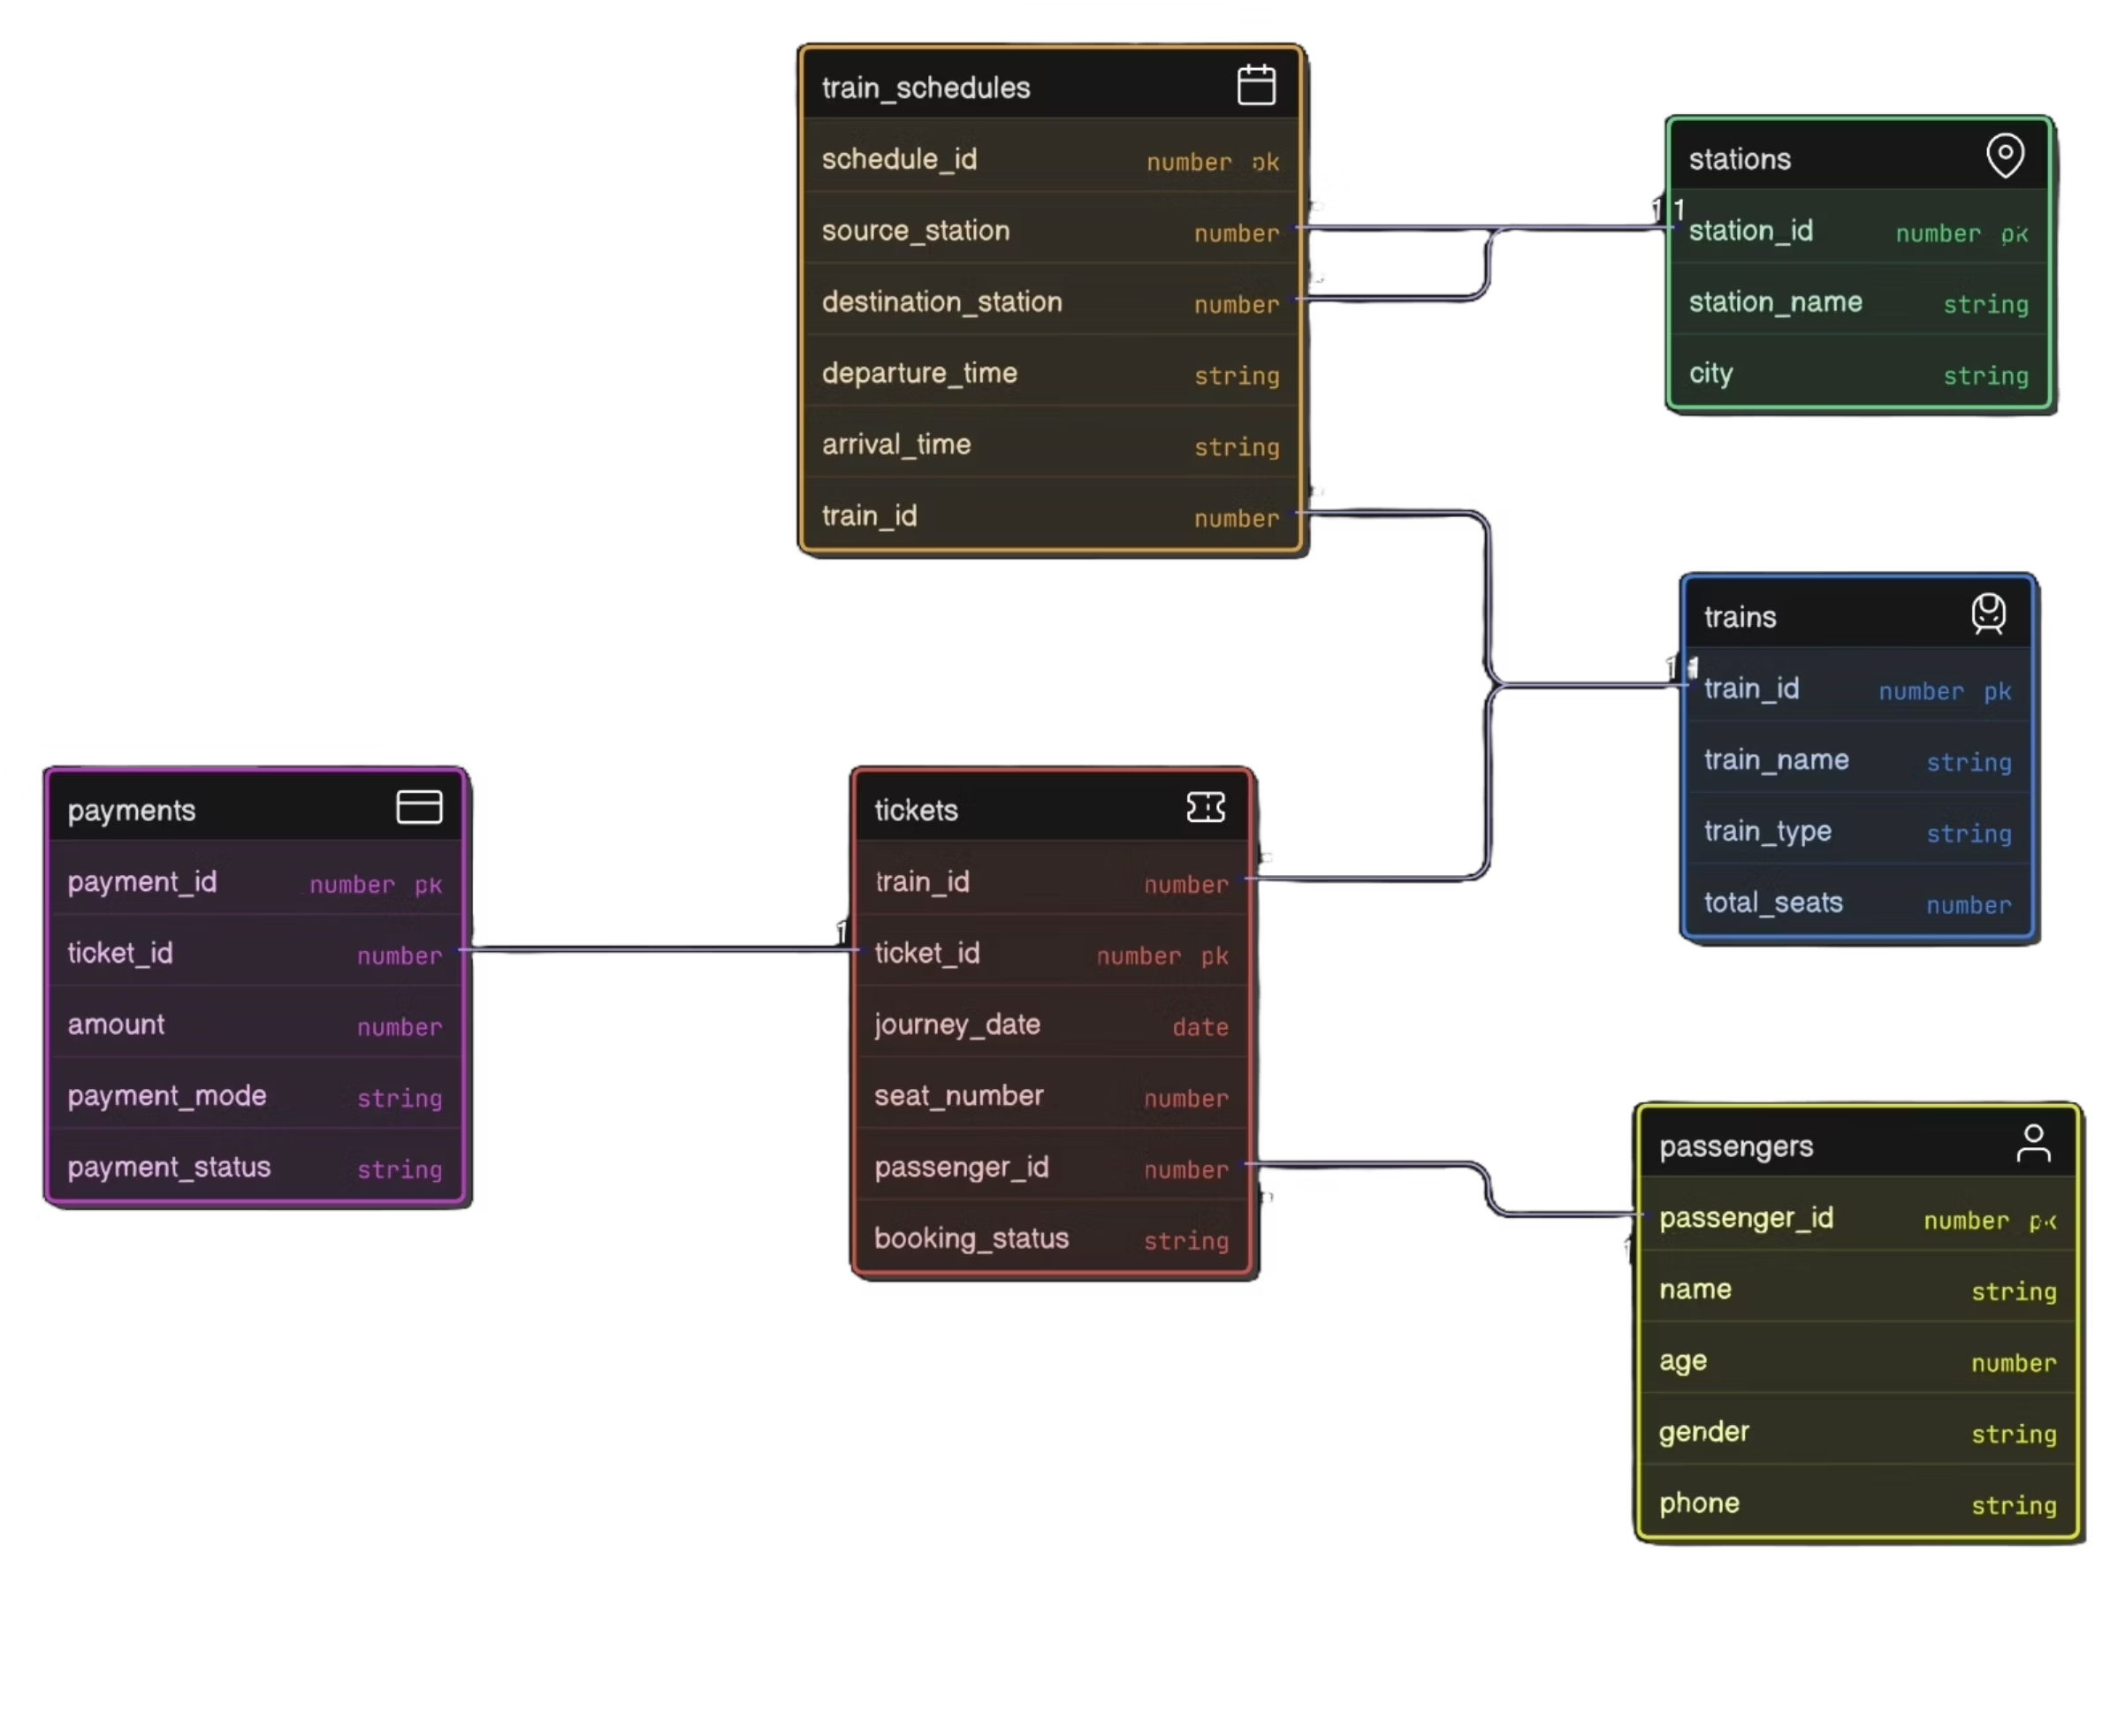
ER DIAGRAM:
Group-1

